Slide 1
Multiple-Source Localization from a Single-Snapshot Observation Using Graph Bayesian Optimization
Zonghan Zhang, Zijian Zhang, Zhiqian Chen
Computer Science and Engineering
Mississippi State University

Slide 2
Agenda
Motivation and Problem Setup
Introduction to Bayesian Optimization
Proposed Method for Multi-Source Localization
Empirical Experiment
Conclusion and Future Directions

Slide 3
Motivation
Source localization is the reverse problem of information diffusion.
Medicine, security, social networks…
Three classes:
Complete observation, monitor observation, and
Most commonly, single-snapshot observation.

Slide 4
Motivation
Two possible solutions:
Simulation-based methods
Heuristic methods
Neither works perfectly:
Simulation-based: too slow, not scalable.
Proxy-based: three major challenges

Slide 5
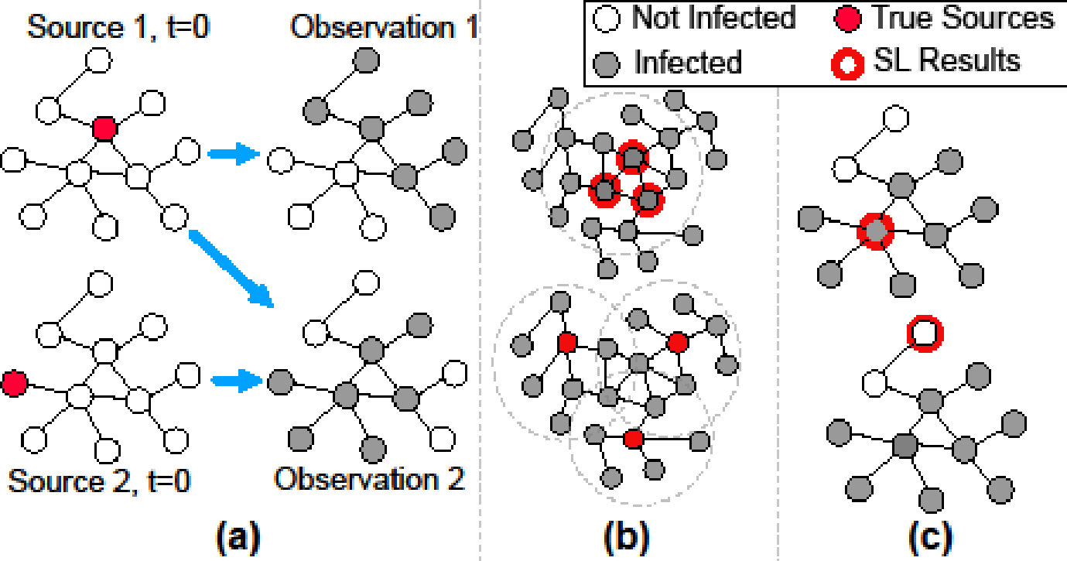
Motivation

Slide 6

Our Problem Setup
Single-snapshot multi-source localization.
Given a size-N graph G = (V, E), one single observation of propagation snapshot o*, and the underlying diffusion model d, identify a source set that maximizes the conditional probability:

Slide 7
Agenda
Motivation and Problem Setup
Introduction to Bayesian Optimization
Why BO fits our problem?
Proposed Method for Multi-Source Localization
Empirical Experiment
Conclusion and Future Directions

Slide 8
Why BO Fits This Problem?
By AnotherSamWilson - Own work, Wikipedia
https://en.wikipedia.org/wiki/Bayesian_optimization

Slide 9
Why BO Fits This Problem?
An approach for optimizing black-box functions that are expensive to evaluate.
It constructs a probabilistic model of the objective function and determines candidates to evaluate next.
Sample efficiency is the key.

Slide 10
Agenda
Motivation and Problem Setup
Introduction to Bayesian Optimization
Proposed Method for Multi-Source Localization
Empirical Experiment
Conclusion and Future Directions

Slide 11
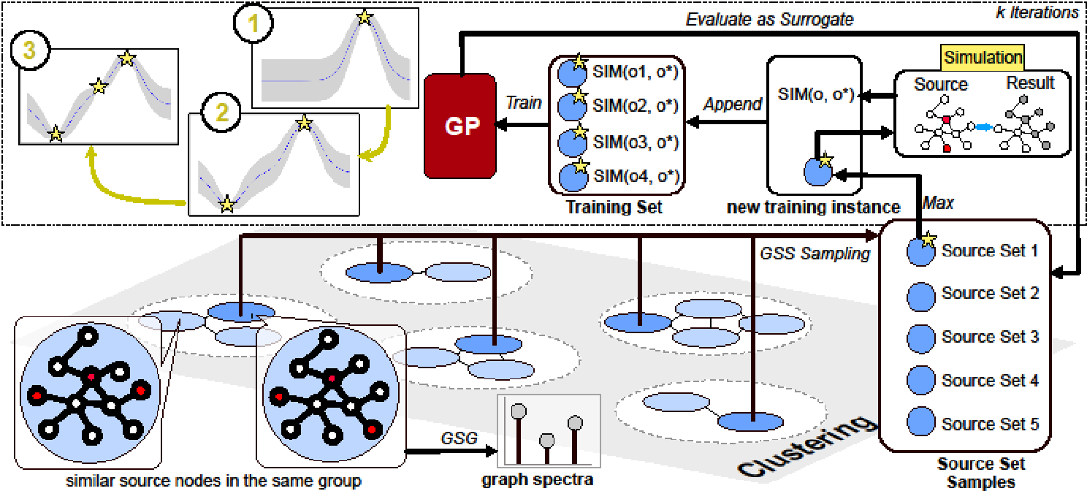
Proposed Model: SIM
Notes:
Overview + one by one

Slide 12
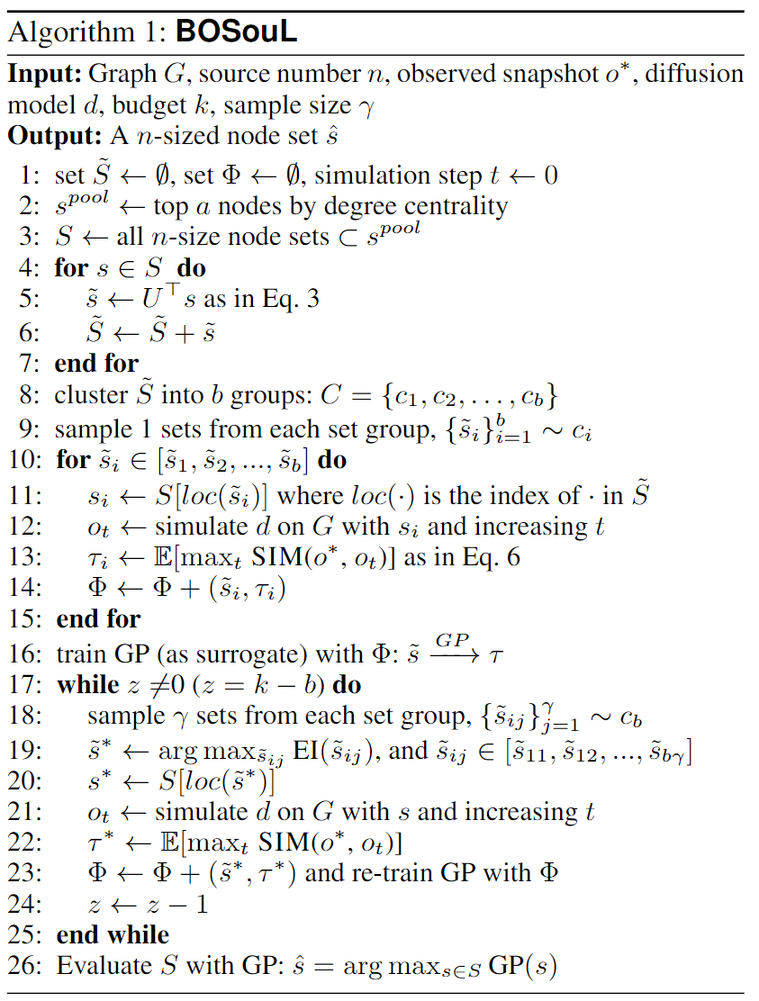
Proposed Model: SIM
Graph spectral Gaussian kernel (GSG)
Apply graph Fourier transform to the source set vectors;
Combine the signal with RBF kernel.
GSG is a valid Mercer kernel for GP.
Graph stratified sampling (GSS)
Cluster over the graph Fourier signals;
Sample equal-size candidates from each cluster.
GSS explores the search space better than random sampling, and has a lower variance.
Notes:
Overview + one by one

Slide 13
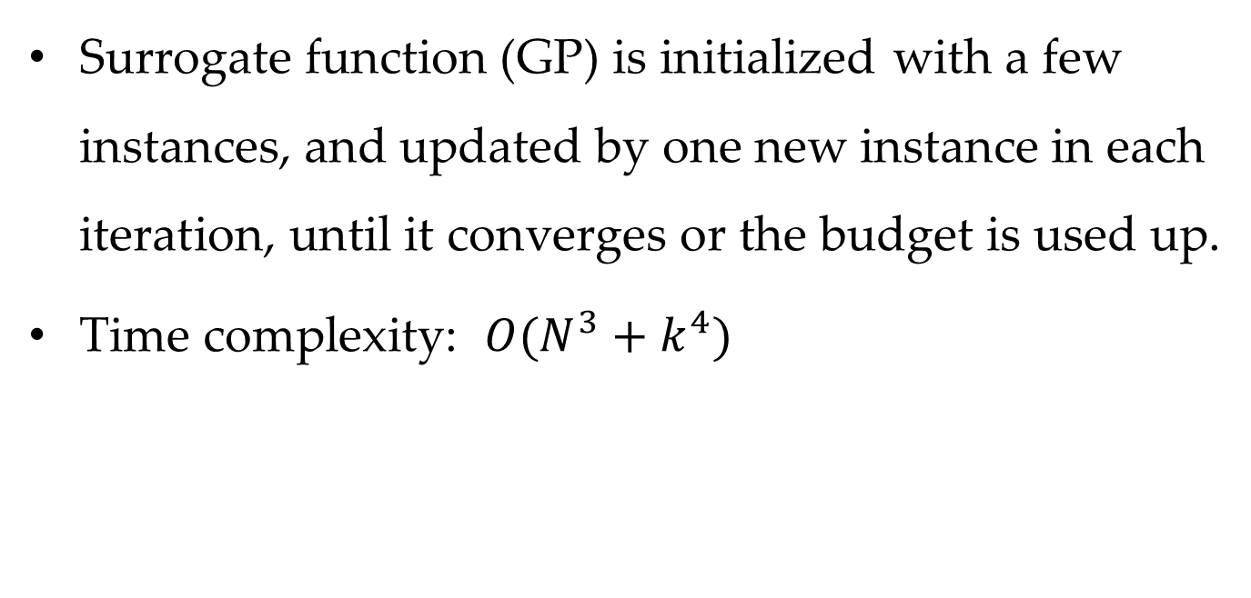
Collecting and Pruning

Slide 14
Agenda
Motivation and Problem Setup
Introduction to Bayesian Optimization
Proposed Method for Multi-Source Localization
Empirical Experiment
Conclusion and Future Directions

Slide 15
Experimental Setup
Datasets:
Three real-world networks: planetoid
Two synthetic networks: small-world and random
Baselines:
Three popular multi-source localization methods

Slide 16
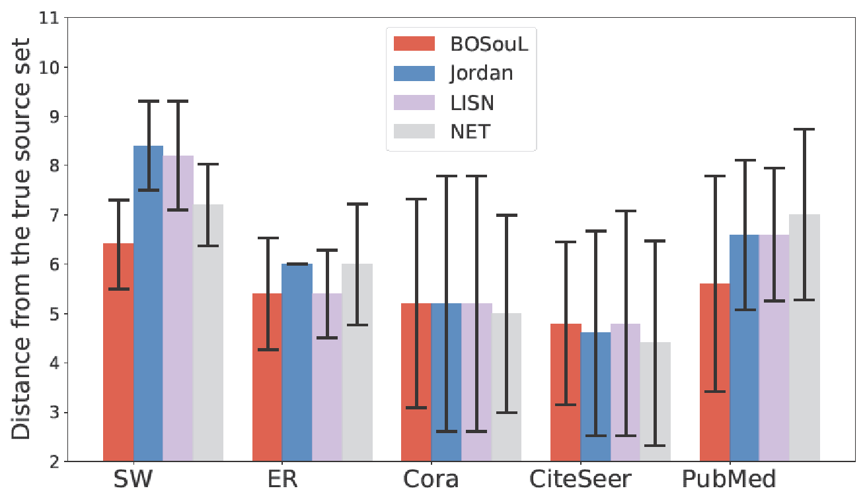
Results: SI

Slide 17
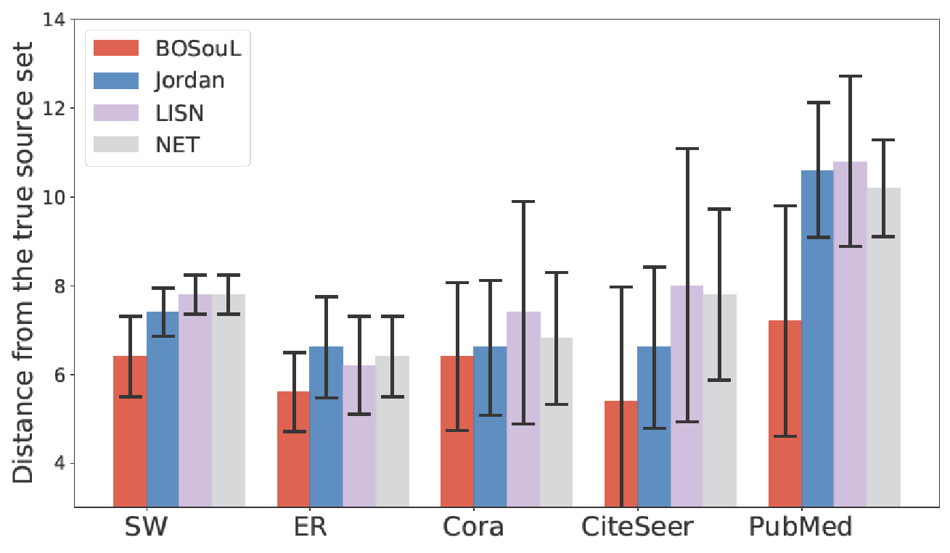
Results: SIR

Slide 18
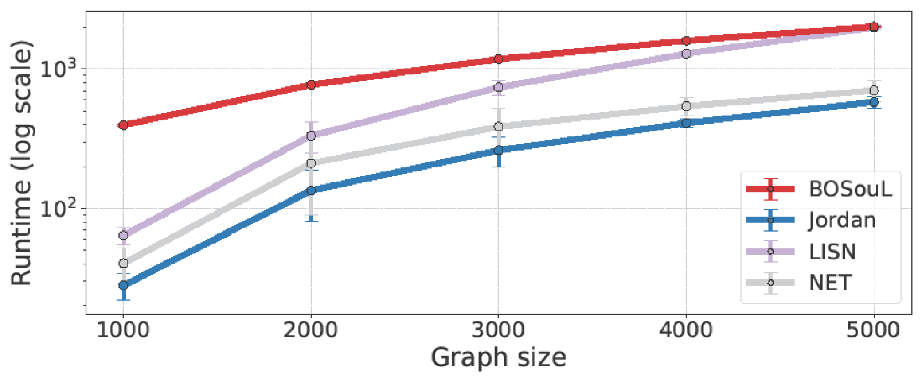
Results: Time

Slide 19
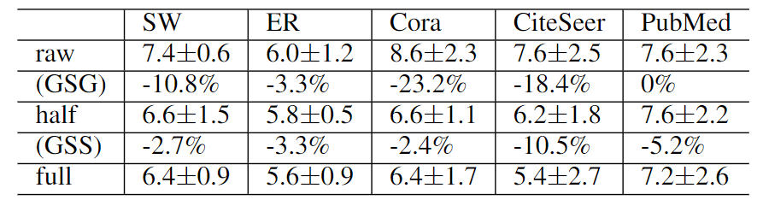
Results: Ablation Test

Slide 20
Agenda
Motivation and Problem Setup
Introduction to Bayesian Optimization
Proposed Method for Multi-Source Localization
Empirical Experiment
Conclusion and Future Directions

Slide 21
Conclusion
BOSouL achieves superior performance with a competitive efficiency.
GSG and GSS are theoretically and practically proved to be useful.

Slide 22
Future Directions
Use parallel computing to further accelerate the evaluation.
Study whether the learned surrogate function can be transferred among circumstances.

Slide 23


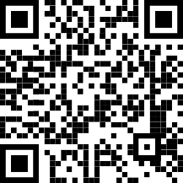
Q&A
Thank you!
Code Here ↓
My Website ↓

